Slide 1
Raman photons in cQED
May 16, 2024
Carla Becker

Slide 2
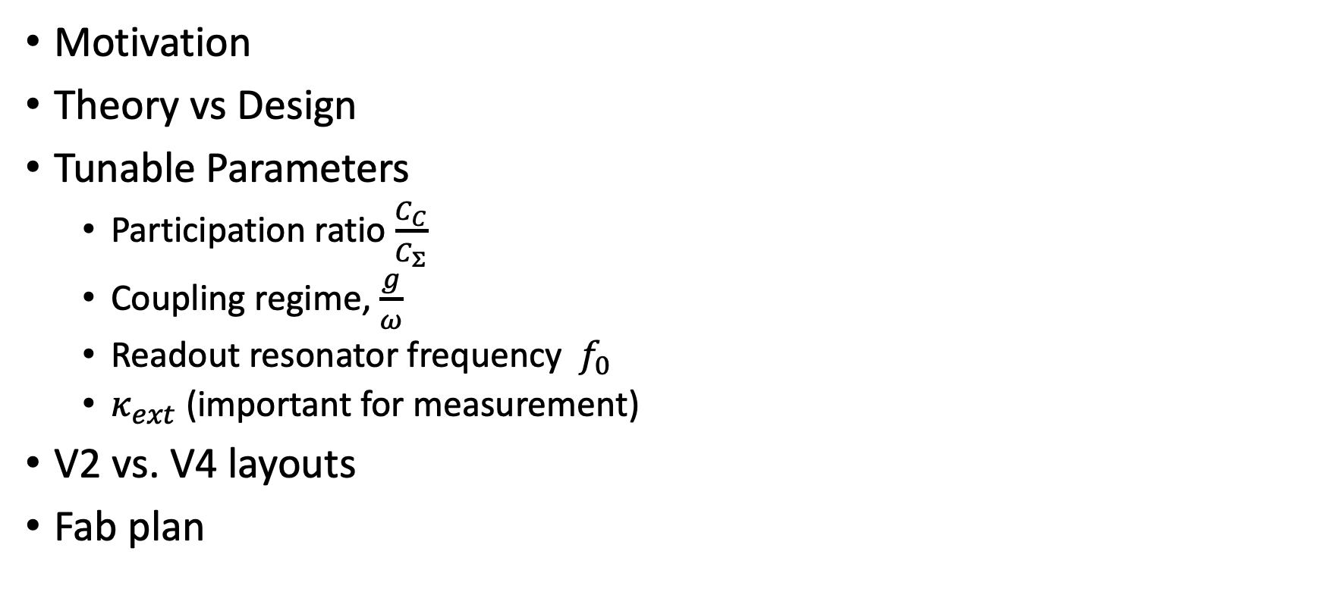
Table of content
Motivation
Theory vs Design
Tunable Parameters
Participation ratio $\frac{C_{C}}{C_{Σ}}$
Coupling regime, $\frac{g}{ω}$
Readout resonator frequency ${ f}_{0}$
$κ_{ext}$ (important for measurement)
V2 vs. V4 layouts
Fab plan

Slide 3
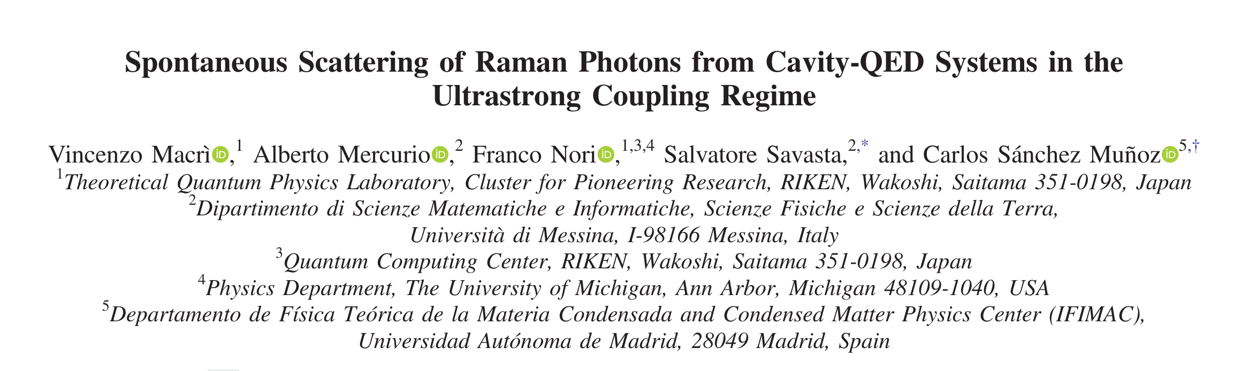
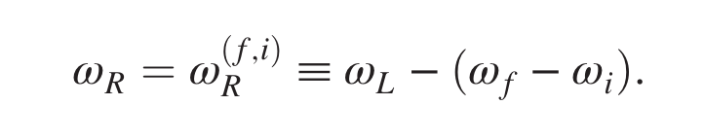
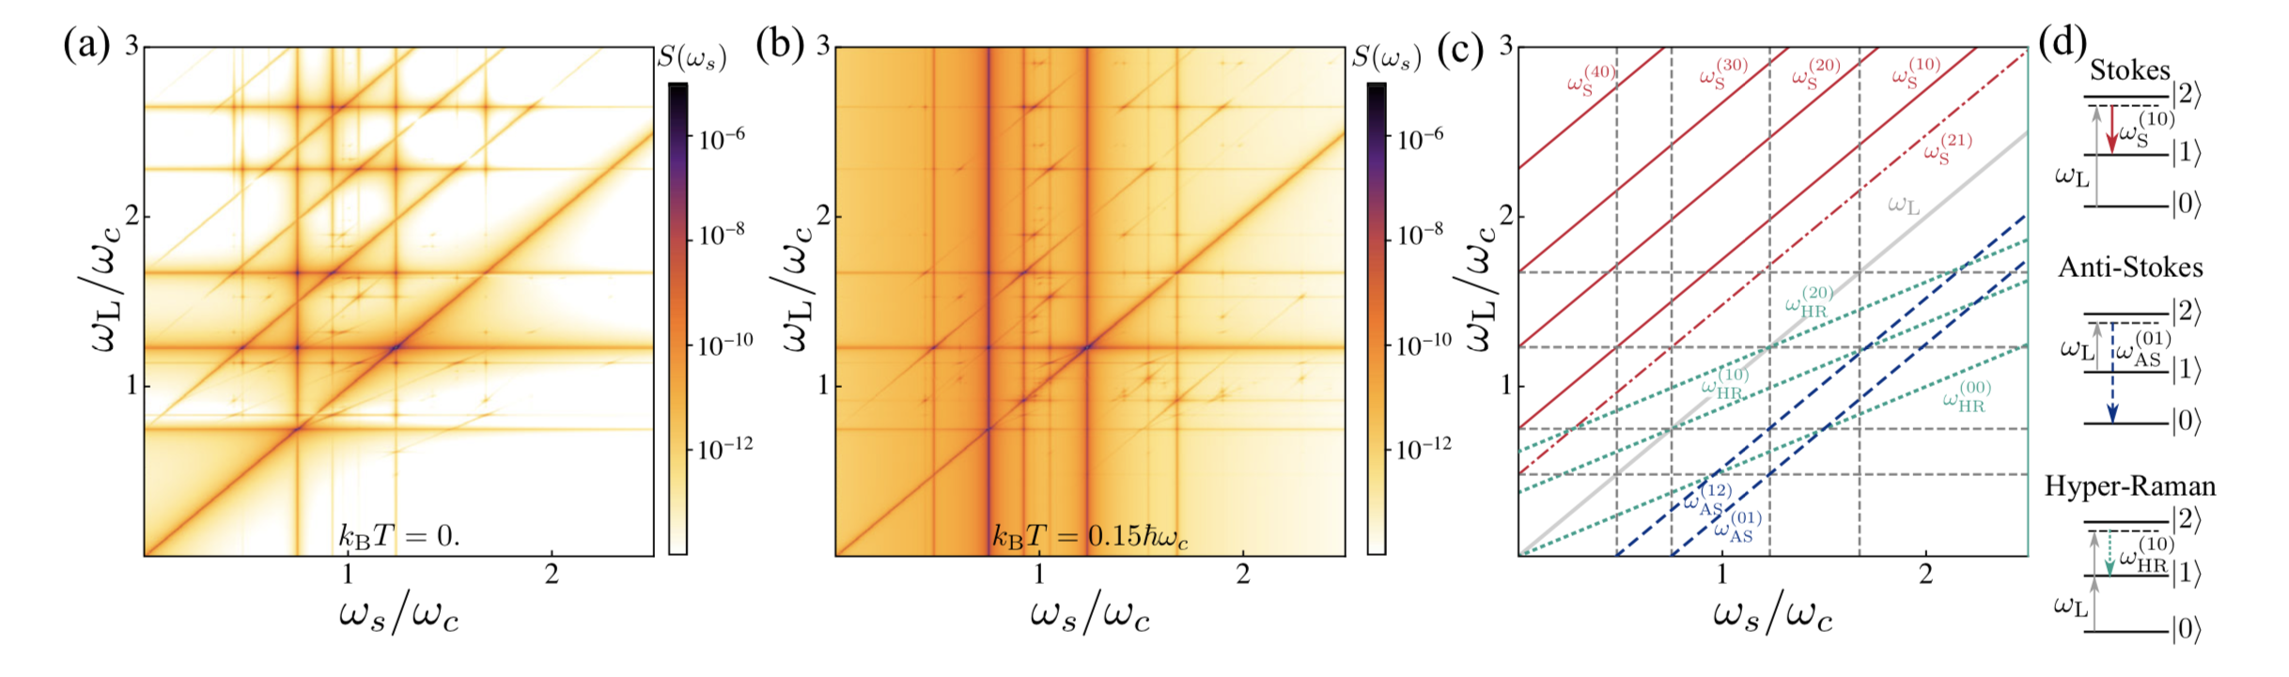
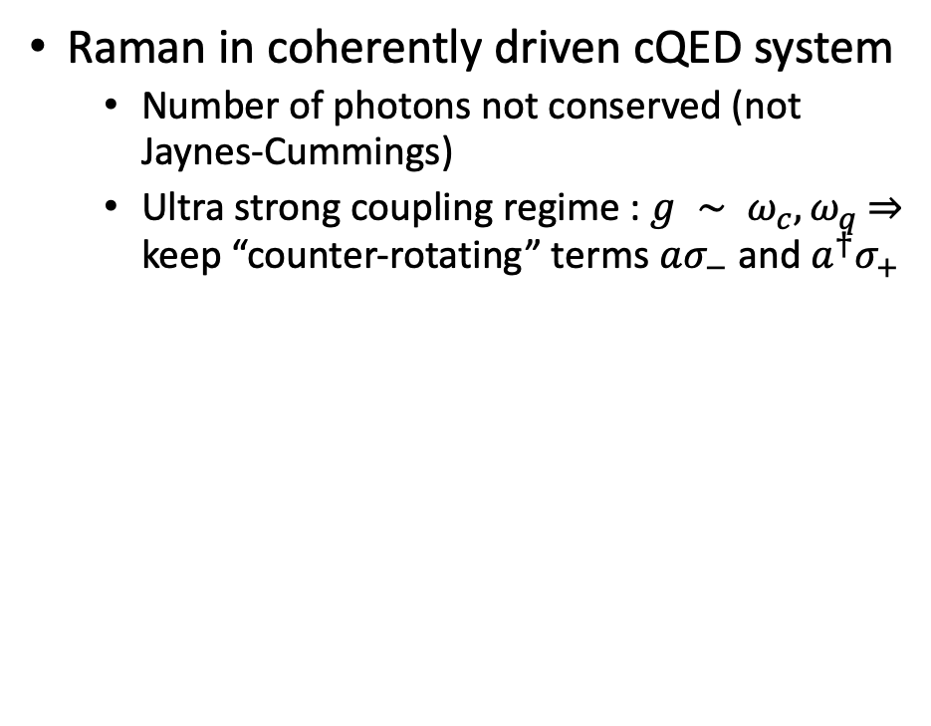
Motivation
Raman in coherently driven cQED system
Number of photons not conserved (not Jaynes-Cummings)
Ultra strong coupling regime : $g ∼ ω_{c}, ω_{q}$ ⇒ keep “counter-rotating” terms $aσ_{−}$ and ${a^{†}σ}_{+}$

Slide 4

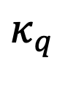
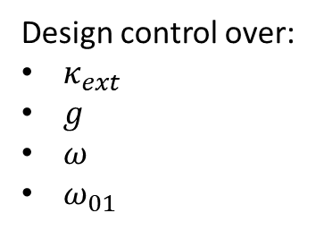
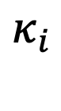
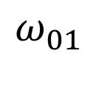
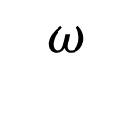
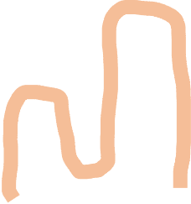
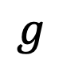
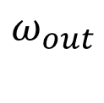
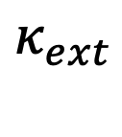

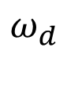
Design (“V1”)
Theory
Design control over:
$κ_{ext}$
$g$
$ω$
$ω_{01}$
$$ω_{out}$$
$$κ_{ext}$$
$$g$$
$$ω$$
$$ω_{01}$$
$$ω_{d}$$
$$κ_{i}$$
$$κ_{q}$$

Slide 5
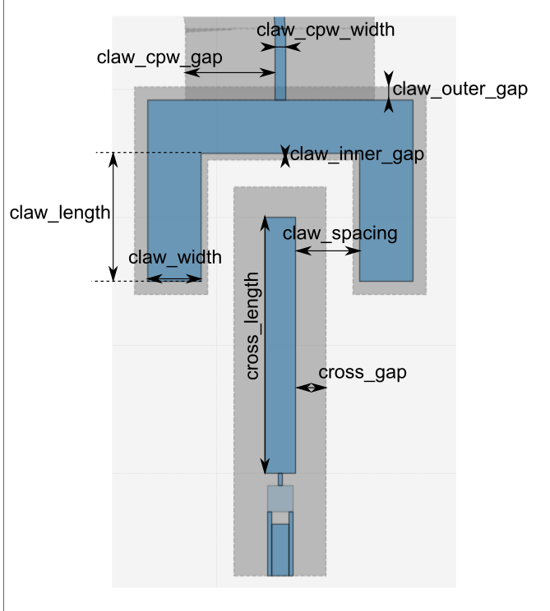
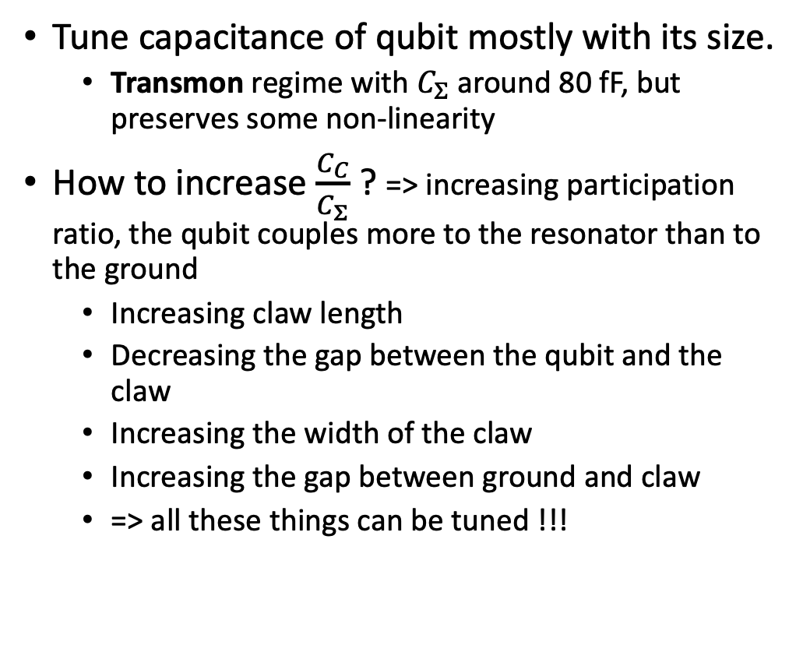
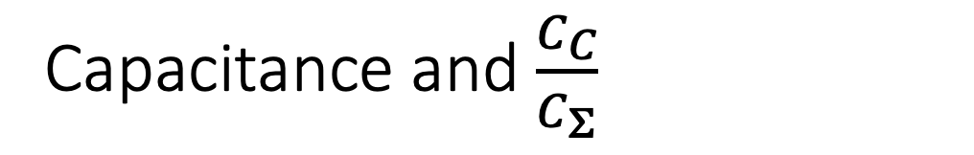
Capacitance and $\frac{C_{C}}{C_{Σ}}$
Tune capacitance of qubit mostly with its size.
Transmon regime with $C_{Σ}$ around 80 fF, but preserves some non-linearity
How to increase $\frac{C_{C}}{C_{Σ}}$ ? => increasing participation ratio, the qubit couples more to the resonator than to the ground
Increasing claw length
Decreasing the gap between the qubit and the claw
Increasing the width of the claw
Increasing the gap between ground and claw
=> all these things can be tuned !!!

Slide 6
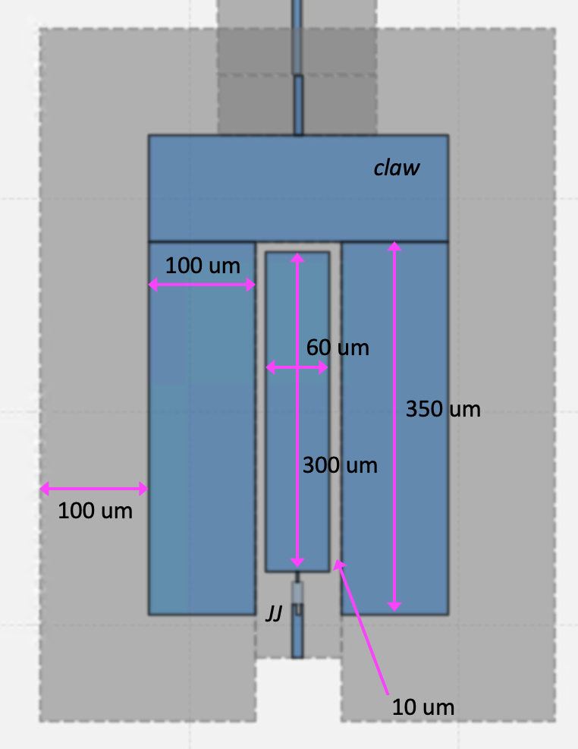
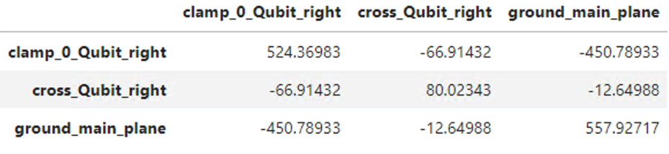
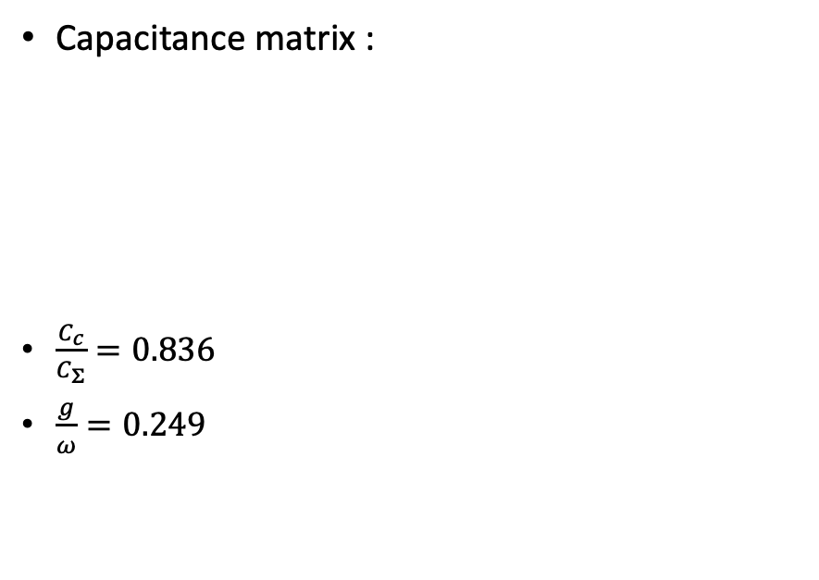
Current design for USC regime
Capacitance matrix :
$\frac{C_{c}}{C_{Σ}}=0.836$
$\frac{g}{ω}=0.249$
Blais et al., 2020

Slide 7
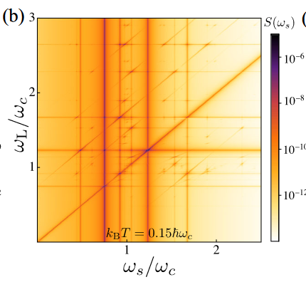

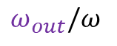
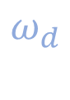
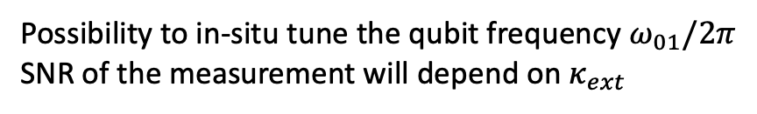
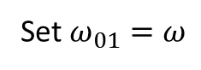
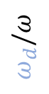
Measurement
Set $ω_{01}=ω$
Constraints
Pump signal : 0-18 GHz
Detection : 4-12 GHz
$$ω_{out}$$
$$κ_{ext}$$
$$g$$
$$ω_{d}/ω$$
$$ω$$
$$ω_{01}$$
$$ω_{out}/ω$$
Possibility to in-situ tune the qubit frequency $ω_{01}/2π$
SNR of the measurement will depend on $κ_{ext}$
$$ω_{d}$$
$$κ_{i}$$
$$κ_{q}$$

Slide 8
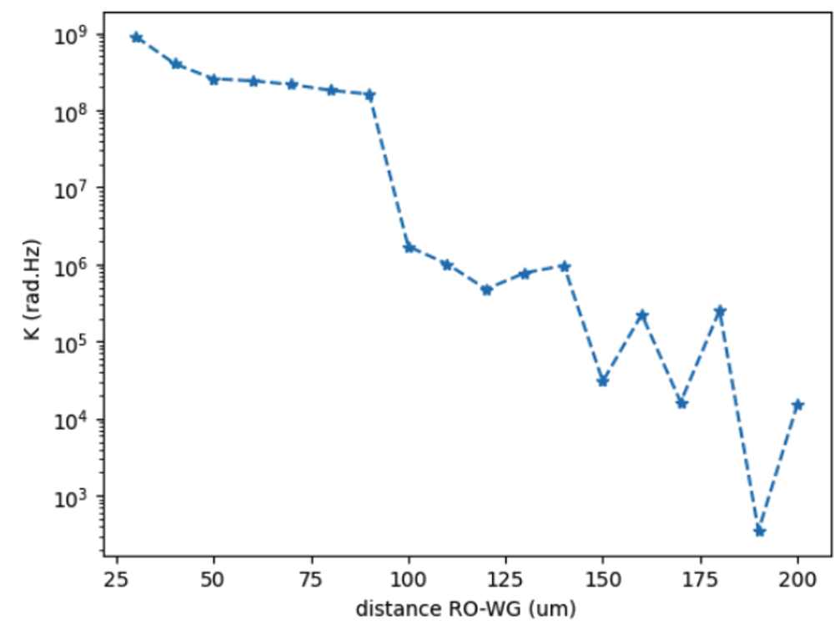
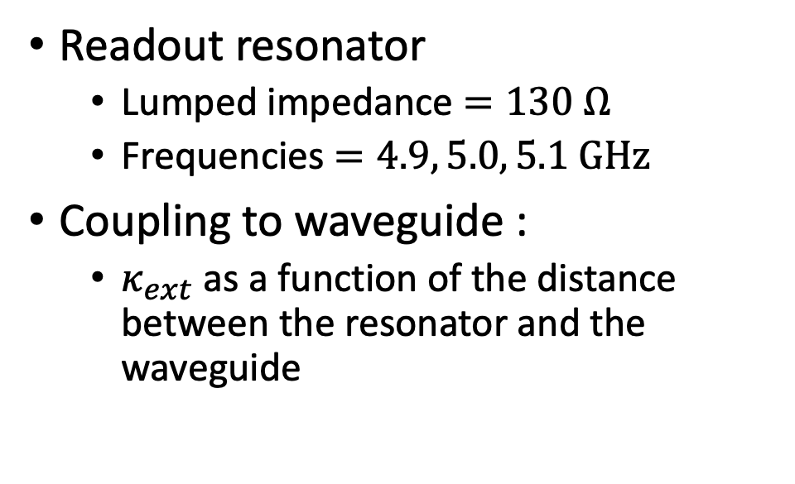
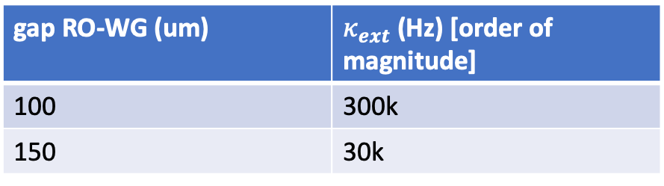
Resonator and waveguide
Figure not up-to-date, was done for V1 with measurement in transmission
Readout resonator
Lumped impedance $=130 Ω$
Frequencies $=4.9, 5.0, 5.1 GHz$
Coupling to waveguide :
$κ_{ext}$ as a function of the distance between the resonator and the waveguide
No ground
Ground
gap RO-WG (um) | $κ_{ext}$ (Hz) [order of magnitude]
100 | 300k
150 | 30k

Slide 9
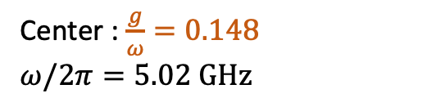
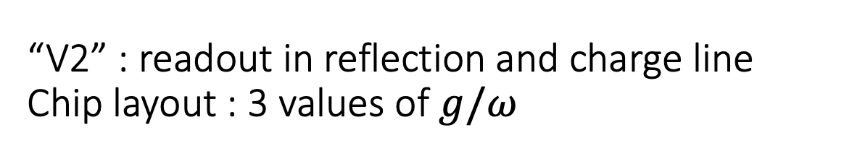
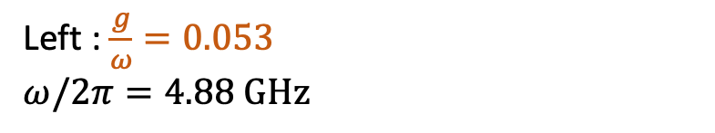
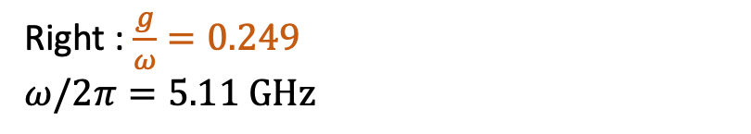
“V2” : readout in reflection and charge line Chip layout : 3 values of $g/ω$
Center : $\frac{g}{ω}=0.148$
$ω/2π=5.02 GHz$
Left : $\frac{g}{ω}=0.053$
$ω/2π=4.88 GHz$
Right : $\frac{g}{ω}=0.249$
$ω/2π=5.11 GHz$

Slide 10
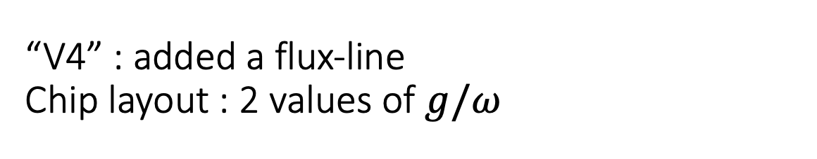
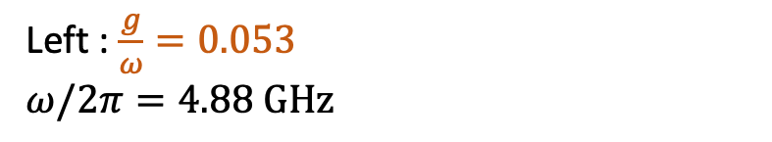
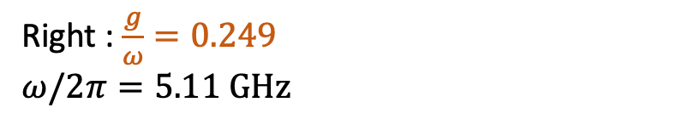
“V4” : added a flux-line Chip layout : 2 values of $g/ω$
Left : $\frac{g}{ω}=0.053$
$ω/2π=4.88 GHz$
Right : $\frac{g}{ω}=0.249$
$ω/2π=5.11 GHz$

Slide 11
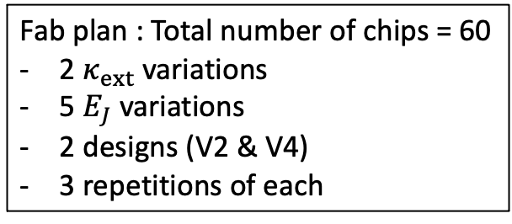
Charge and flux lines
Coupling claw to charge line : 0.5 fF
Asymmetric junctions to tune the qubit in frequency
Fab : 5 variations
Fab plan : Total number of chips = 60
2 $κ_{ext}$variations
5 $E_{J}$ variations
2 designs (V2 & V4)
3 repetitions of each

Slide 12
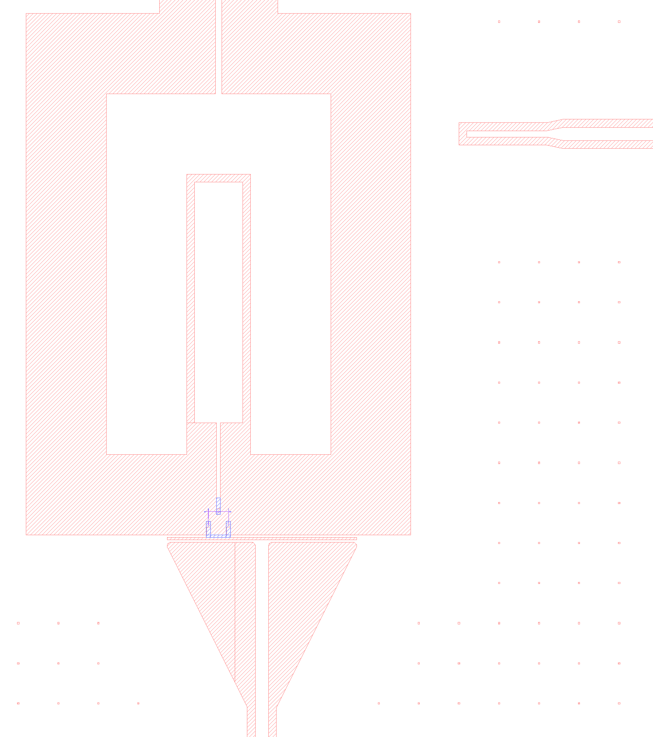
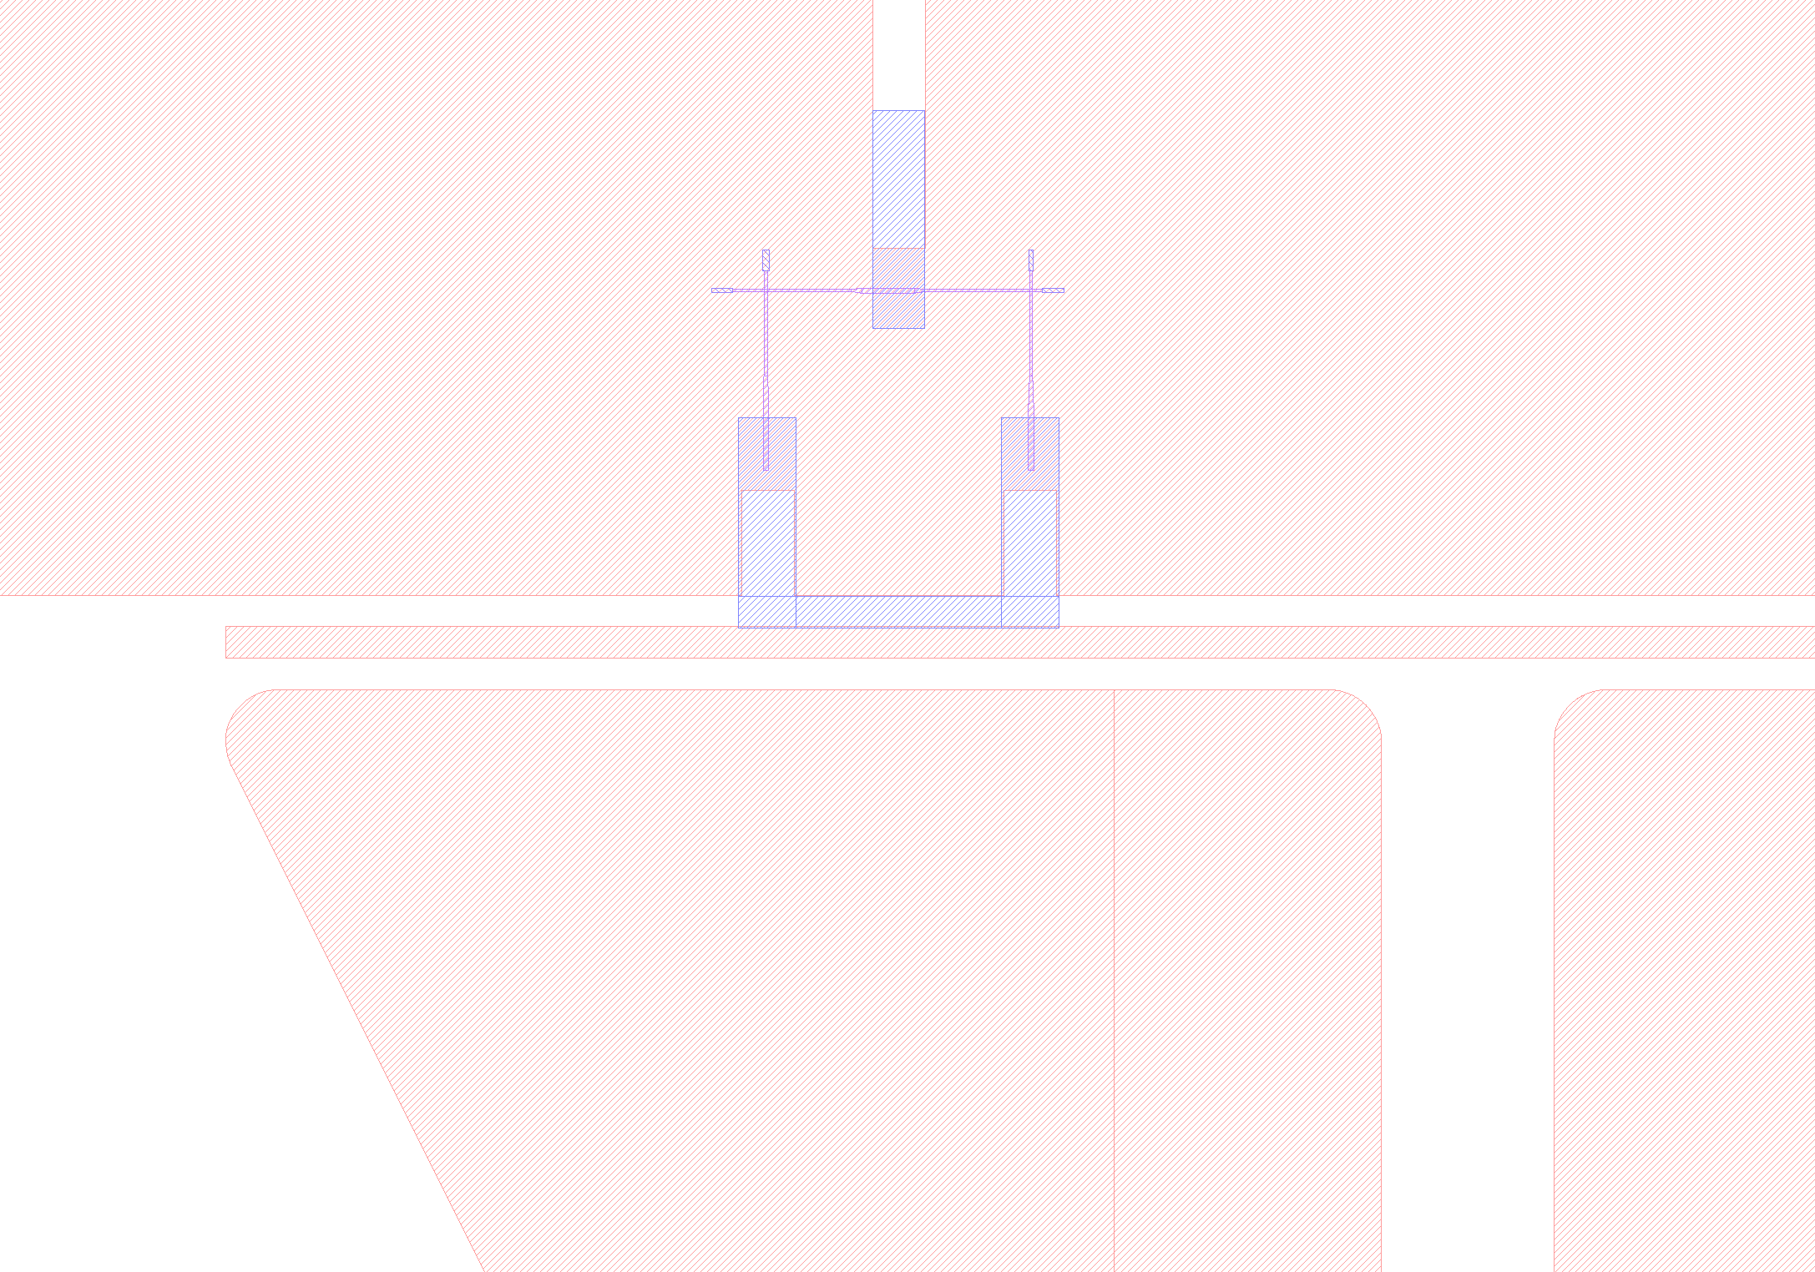
GDS file of V4

Slide 13
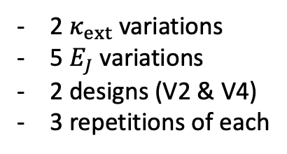
Fab plan
2 $κ_{ext}$variations
5 $E_{J}$ variations
2 designs (V2 & V4)
3 repetitions of each
60 devices

